Slide 1
Fix violation in RBT

Slide 2
Two different states :
Black uncle : rotate
Red uncle : color flip
After rotation :
After color flip :
r
r

Slide 3
Rr : left rotation
Rl : right left rotation
lr : left right rotation
LL : right rotation

Slide 4
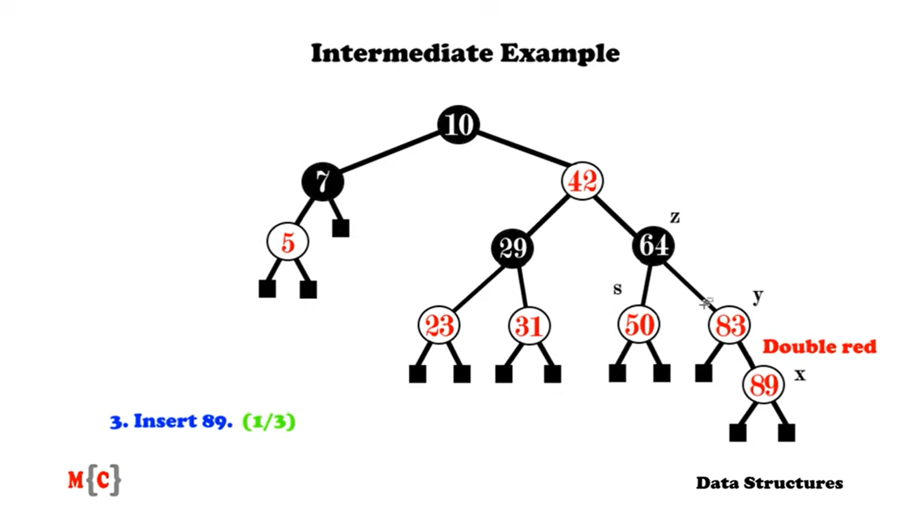
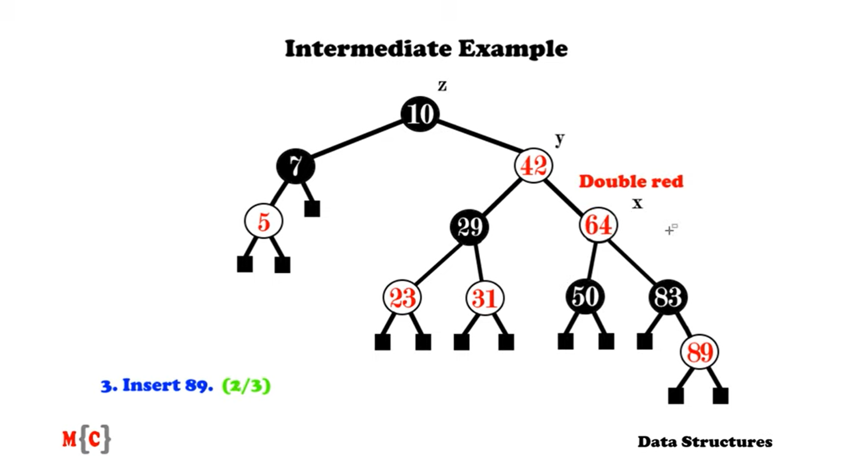
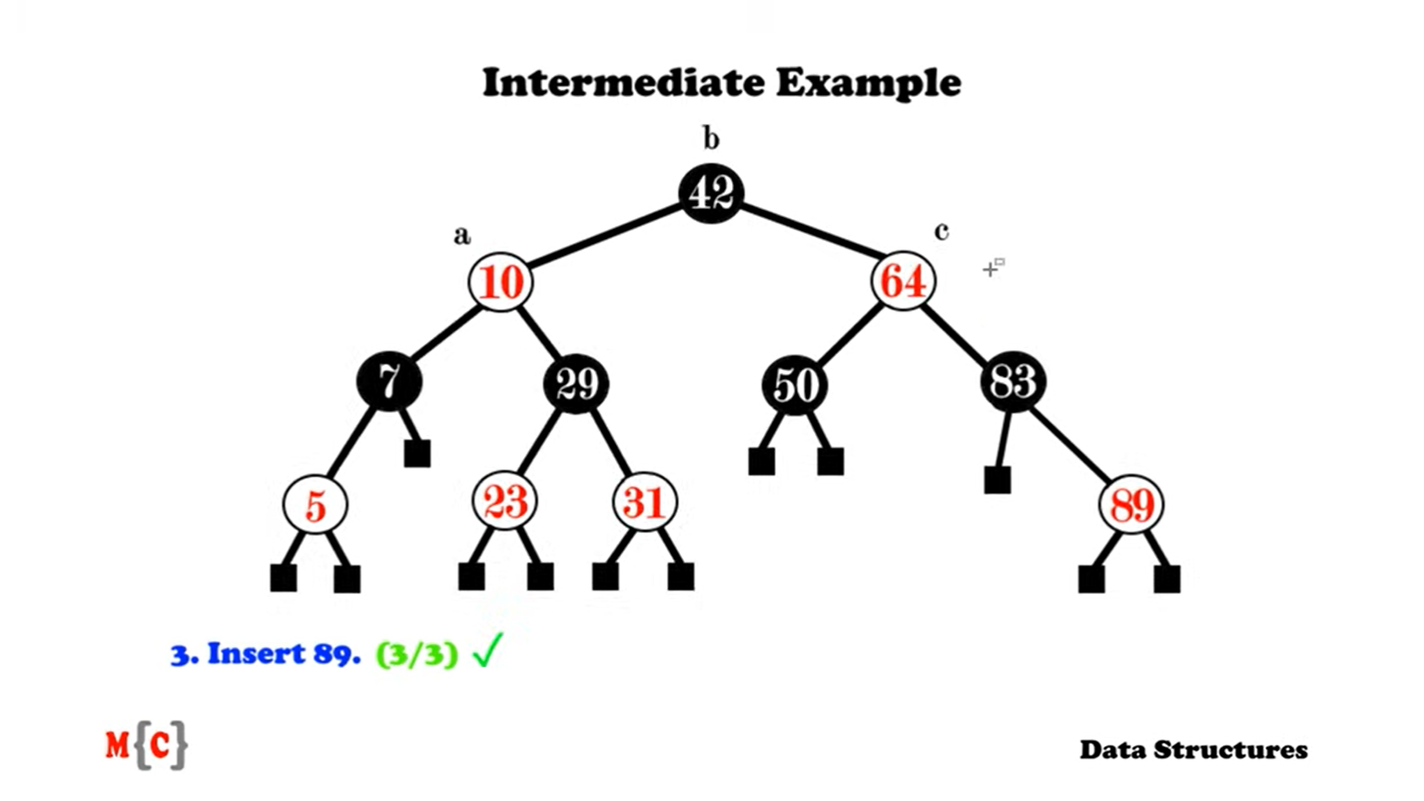
Example :

